Slide 1


Analysis of Minnesota Interstate Traffic Volume
By Jessica Haire

Slide 2
Business Problem
Are infrastructure changes needed on the Interstate?

Slide 3
Charts Used in Analysis
Monthly Traffic Volume:
Showing traffic trend by month for 2017 and 2018.
Hourly Traffic Volume:
Traffic trend analyzed by the hour
Traffic Volumes in Different Weather Conditions:
How does weather impact traffic volume?
Holiday Traffic Volume:
Does traffic change significantly on holidays?

Slide 4
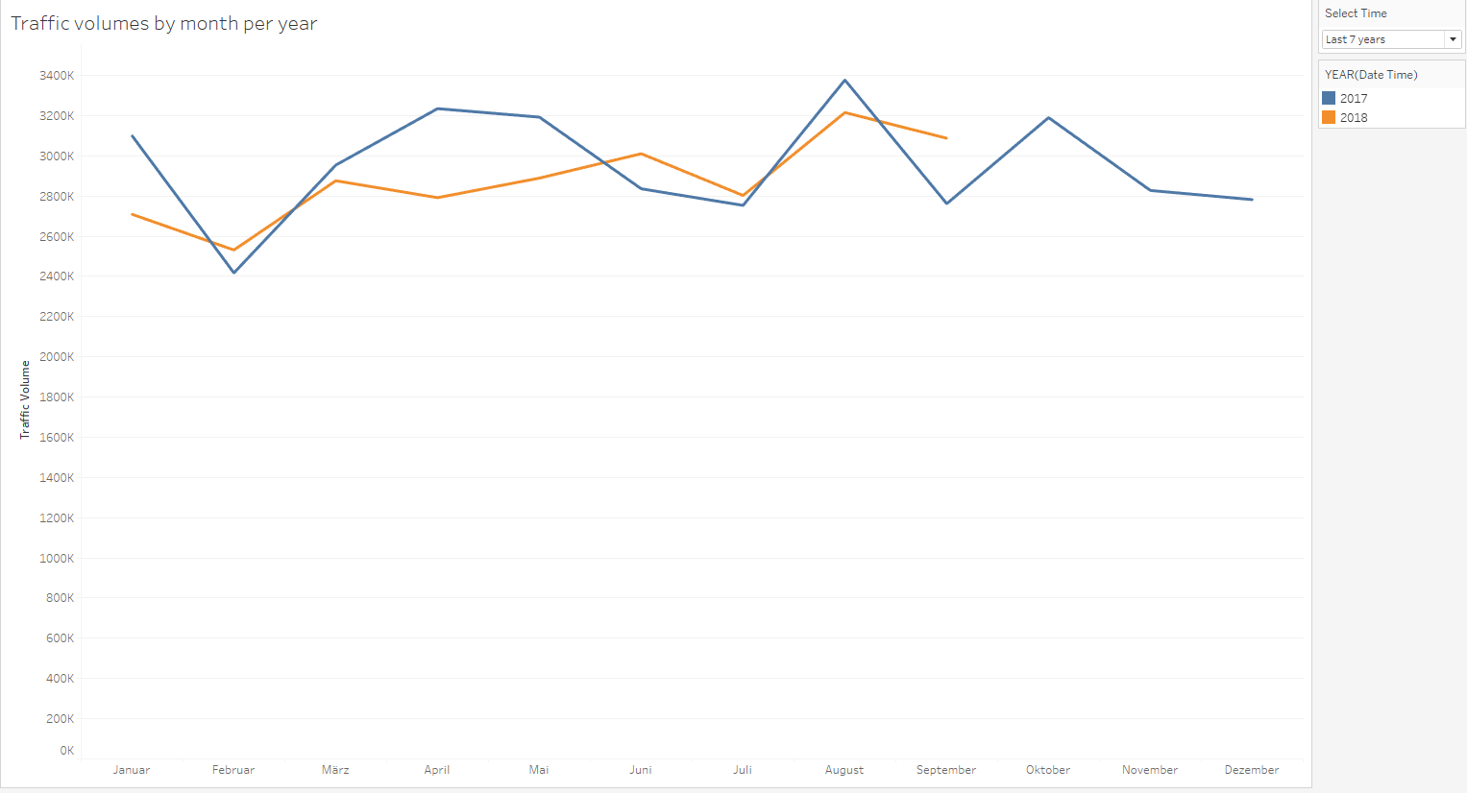
Monthly Traffic Volume
Insights:
There is less traffic in 2018 than in 2017.
The trends between the years are similar with dips in February and peaks in August.

Slide 5
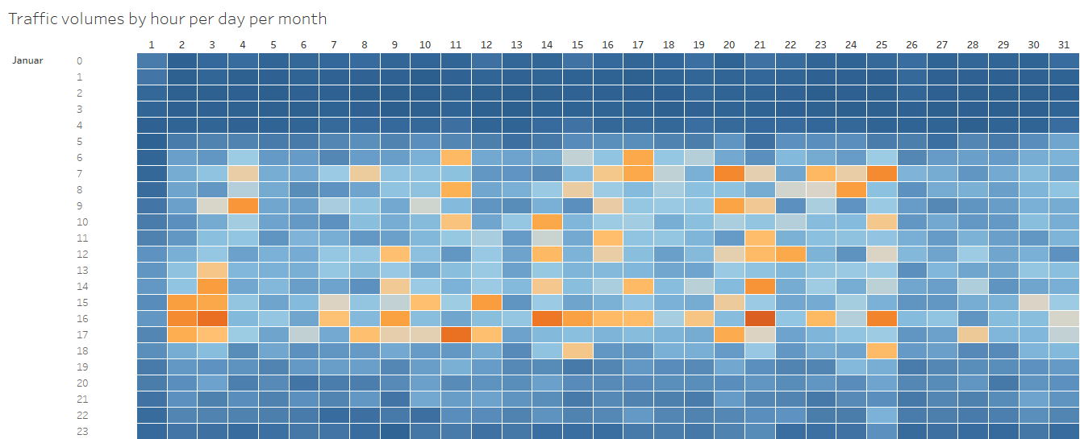
Hourly Traffic Volume
Insights:
Highest volume during rush hour.

Slide 6
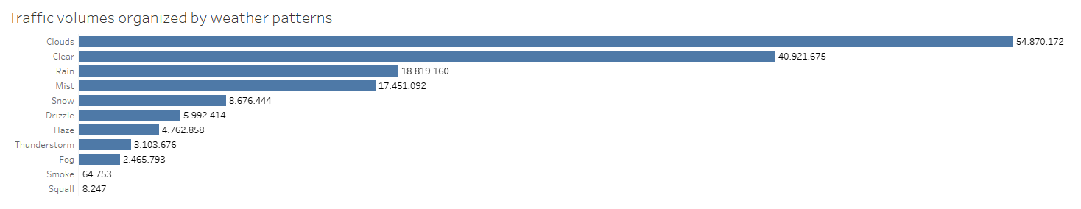
Traffic Volumes by Weather Patterns
Insights:
Cloudy weather seems to attract the highest volume.
Interestingly, drizzle traffic volume is less than rain. This could be researched further.

Slide 7
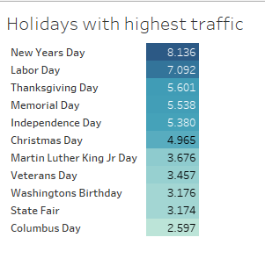
Holiday Traffic
Insights:
New Years Day has the highest volume followed by Labor Day.
Holiday traffic is significantly low compared to non holidays.

Slide 8
Thank you..

